Slide 1
Logistic Regression
Y = 0 or 1

Slide 2
Binary Variables
Binary independent variables are coded 0 if the variable’s condition is not met and 1 if the variable’s condition is met
Binary independent variables are used for dummy and/or categorical variables
Sales = B0 + B1(Advertising) + B2(Rain) + E
Interpretation of B2: The change in sales associated with rainy days versus non-rainy days
Date | Sales | Advertising | Rain
7/1 | 30 | $100 | 0
7/2 | 35 | $125 | 1
7/3 | 33 | $120 | 1

Slide 3
Binary Variables
We can also have binary dependent variables.
Used for classification problems
Pass or fail? Win or lose? Accept or reject?
Pass Exam | Study Time | Days Absent | Stats Major
1 | 10 | 2 | 0
1 | 11 | 1 | 1
0 | 3 | 4 | 0

Slide 4
The Linear Probability Model
Pass or Fail = B0 + B1(Study Time) + B2(Days Absent) + B3(Stats Major)
If handled by OLS, this is called a linear probability model
Interpretation of B2: The change in the probability of passing the exam associated with an additional day absent
Pass Exam | Study Time | Days Absent | Stats Major
1 | 10 | 2 | 0
1 | 11 | 1 | 1
0 | 3 | 4 | 0

Slide 5
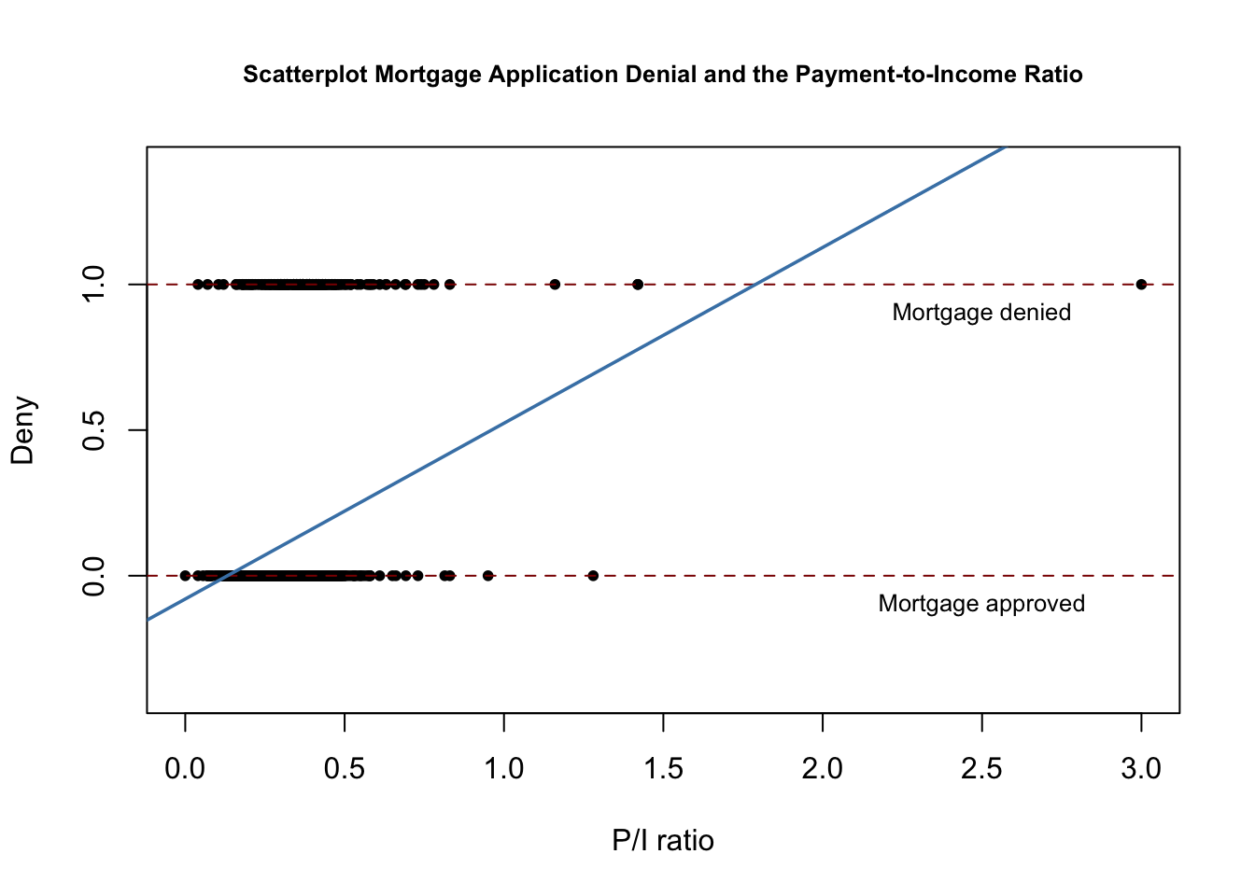
Problems with the Linear Probability Model
Easy to use
But has lots of problems
Errors aren’t normally distributed since Y only takes two values.
Errors are are heteroskedastic
Predicted probabilities can be above 1 or below 0
Use logistic regression instead!

Slide 6
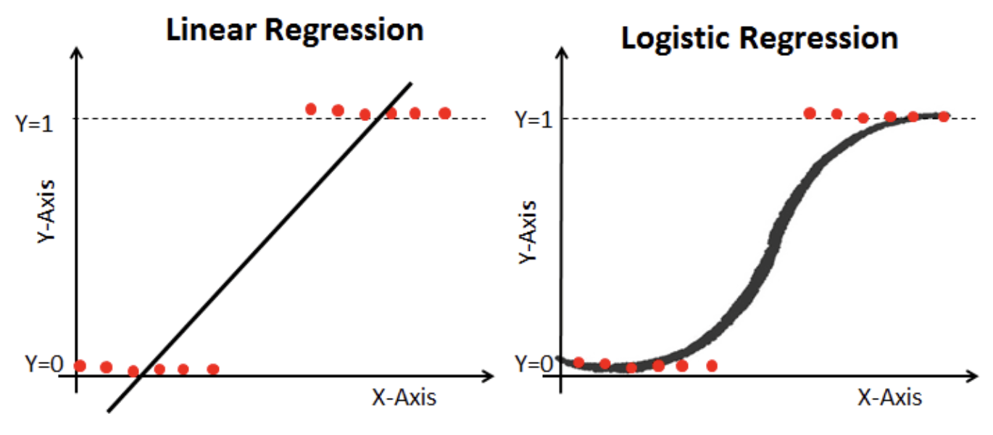

Slide 7
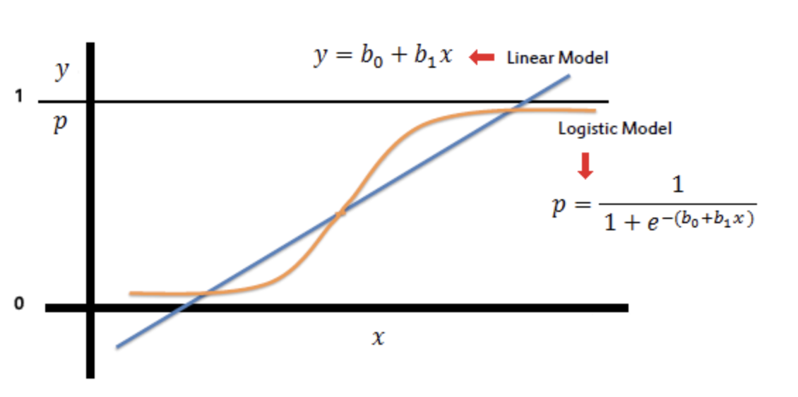

Slide 8
Likelihood and Maximum Likelihood Estimation
Likelihood: A measure of the probability of getting the given data given specific parameter values
Maximum Likelihood Estimation: A procedure for estimating parameters given an an assumed distribution and data
Logistic regression is estimated using MLE, not OLS
https://arunaddagatla.medium.com/maximum-likelihood-estimation-in-logistic-regression-f86ff1627b67

Slide 9
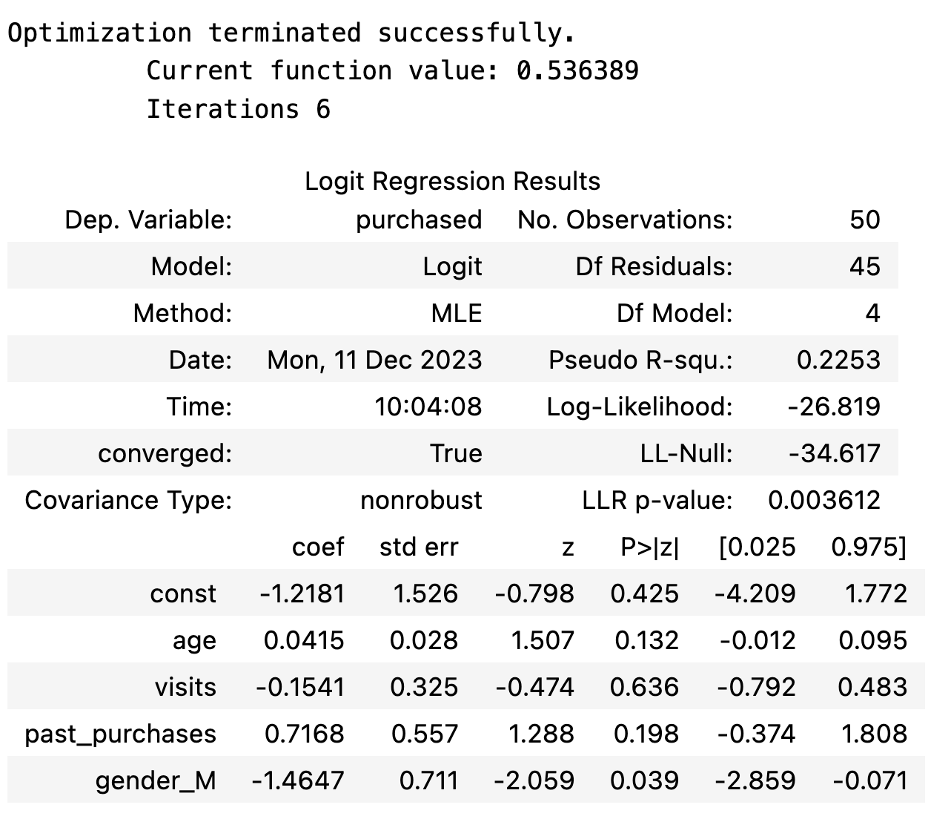
Interpreting Logit Results
Pseudo R^2: Not the same as R^2, but higher is generally better
Log-Likelihood: No direct interpretation, but useful as input in calculation for comparing models
Log-Likelihood Null: The log-likelihood for a model with no explanatory variables
LLR p-value: Similar to p-value for an F-Test for full model, testing HO: B1 + B2 + BN = 0.

Slide 10
Pseudo R^2
There is no R^2 for logistic regression, but there is “Pseudo R^2”
They are similar is concept, but not the same and interpretation is not the same at all.
There are several formulations: Statsmodels uses McFadden’s Pseudo R^2 by default.
= 1 - (ln(Lm)/ln(Lo)), where Lm is the likelihood for the fitted model and Lo is the likelihood for a model without any predictors.
Pseudo R^2…
Can be used to compare models.
Is often low, relative to R^2 from OLS
Is bound between 0 and 1, with higher values indicating a better fit
Cannot be used to compare models of different types or different dependent variables

Slide 11
Interpreting Logit Results
Odds = Probability / 1 - Probability
log(p / 1-p) = log(odds) = B0 + B1X1
Interpretation of Coefficients:
A one unit increase in X1 will result in a B1 increase in log(odds) of Y = 1
A one unit increase in X1 will result in an e^B1 increase in the odds of Y = 1
One additional year of life correlates with a 0.0415 point increase in the log odds of purchasing and a 1.04 point increase in the odds of purchasing
Confusing and not very helpful, right?!

Slide 12
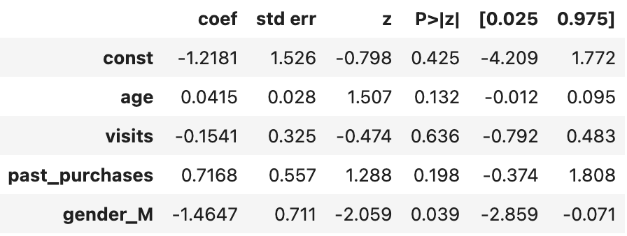
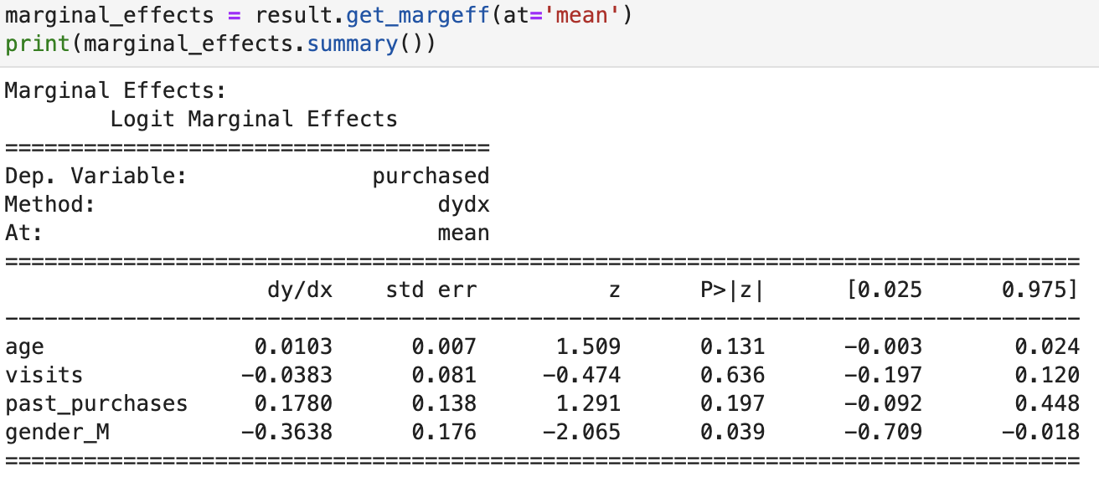
Interpreting Logit Results - Marginal Effects
Marginal Effects: The average change in the probability of Y=1 associated with a single unit increase in X, when all other variables are set to their mean values
For each additional year of life, the probability of purchasing increases by 1.03 percent
For each additional past purchase, the probability of purchasing increases by 17%
Marginal effects are much more useful and can be calculated by Python, R, and most other stats software.

Slide 13
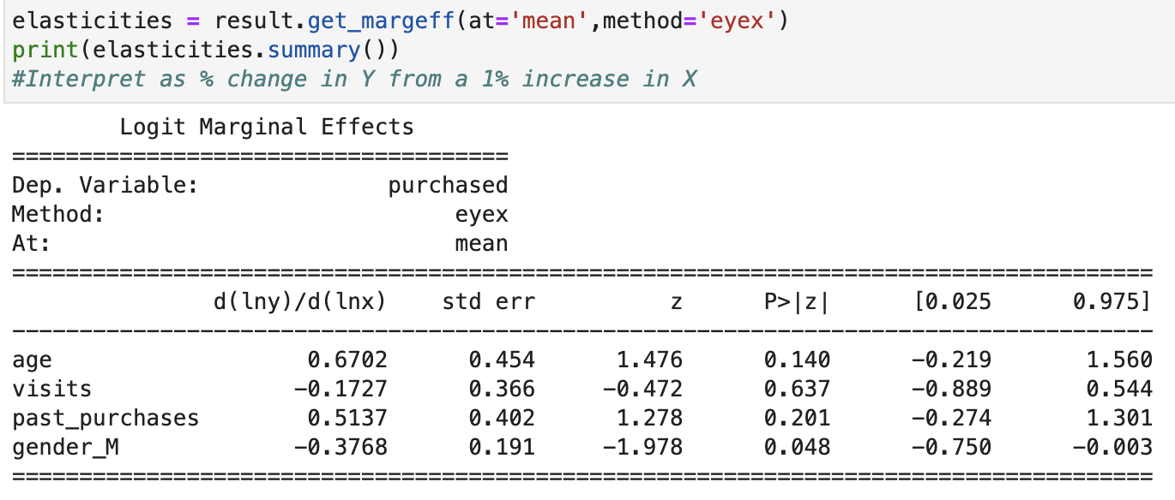
Interpreting Logit Results - Elasticity
Elasticity: The change in the probability of Y=1 associated with a 1% increase in X
A 1% increase in age corresponds to a 67% increase in the probability of purchasing
For each additional percent increase in past purchases, the probability of purchasing increases by 51.37%

Slide 14
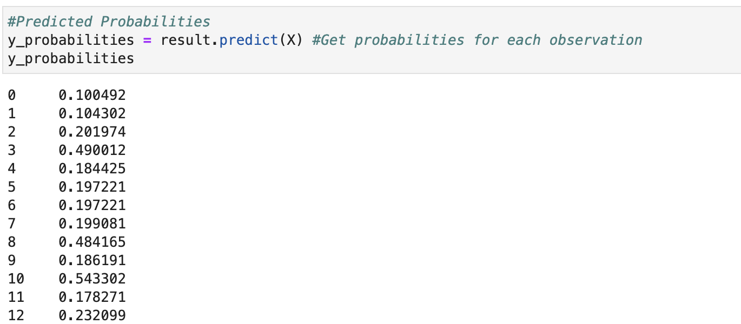
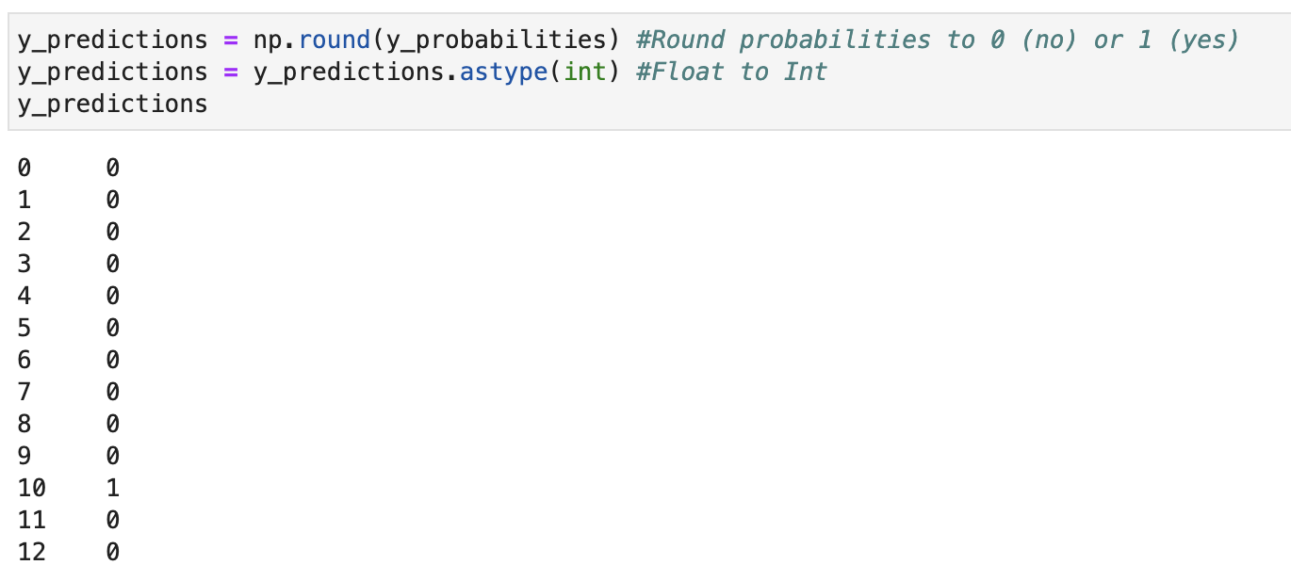
Probabilities and Prediction
Y-Hat is the probability of Y being 1
Prediction is done by recoding Y-Hat as either 0 or 1 depending on distance to the cutoff (typically 0.5)

Slide 15
Confusion Matrix
Four Possible Outcomes
True positive: Case is positive and predicted positive
True negative: Case is negative and predicted negative
False negative: Case is positive but predicted negative
False positive: Case was negative but predicted positive
Confusion Matrix:
TP | FN
FP | TN

Slide 16
Classification Report
Accuracy = (TP + TN) / (TP + FP + FN + TN)
Accuracy tells the percentage of predictions made correctly
Precision = TP / (TP + FP)
Precision tells us what percentage of positive identifications was actually correct.
Precision = 0.73 = Out of all customers that the model predicted would purchase, 73% of them did
Recall = TP / (TP + FN)
Recall tells us what percentage of actual positives the model correctly identified.
Recall = 76% = Out of all the customers that actually purchased, the model predicted this correctly for 76% of them
F1 = 2*(Recall * Precision) / (Recall + Precision)
F1 is the weighted harmonic mean of precision and recall. Closer to 1 = better.

Slide 17
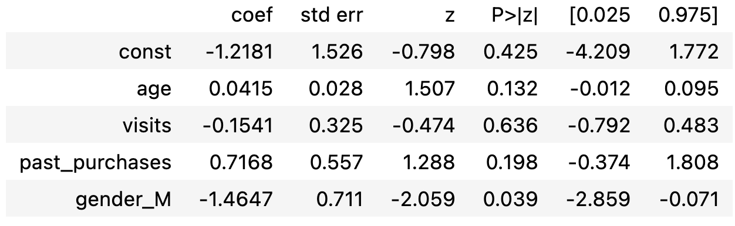
Hypothesis Testing / Statistical Significance
Z = Coefficient (- H0) / Standard Error
(…or does it?)
Find CV from Z table for a selected level of alpha
If abs(Z) > abs(CV), reject the null hypothesis
Or, if p < alpha, reject the null hypothesis

Slide 18
Comparing Models
Statistic | Higher is
Pseudo R^2 | Better
AIC | Worse
BIC | Worse
Accuracy | Better
Precision | Better
Recall | Better
F1 | Better

Slide 19
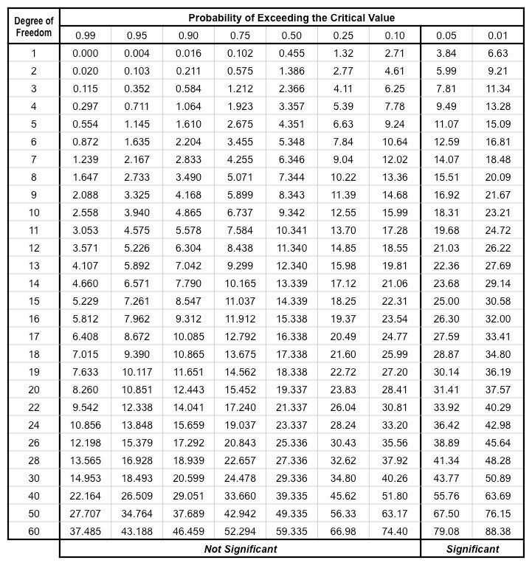
Comparing Nested Models - Likelihood Ratio Test
Full Model: The model with all final independent variables included
Reduced Model: A model with only some of the independent variables included in the full model and no independent variables that are not included in the full model
LLR Test Stat = -2 * (log-likelihood of reduced model - log-likelihood of full model)
CV = Chi-Squared for degrees of freedom = number of variables dropped in reduced model
If Stat > CV, reject null hypothesis that additional variables do not add significant predictive power to the model

Slide 20
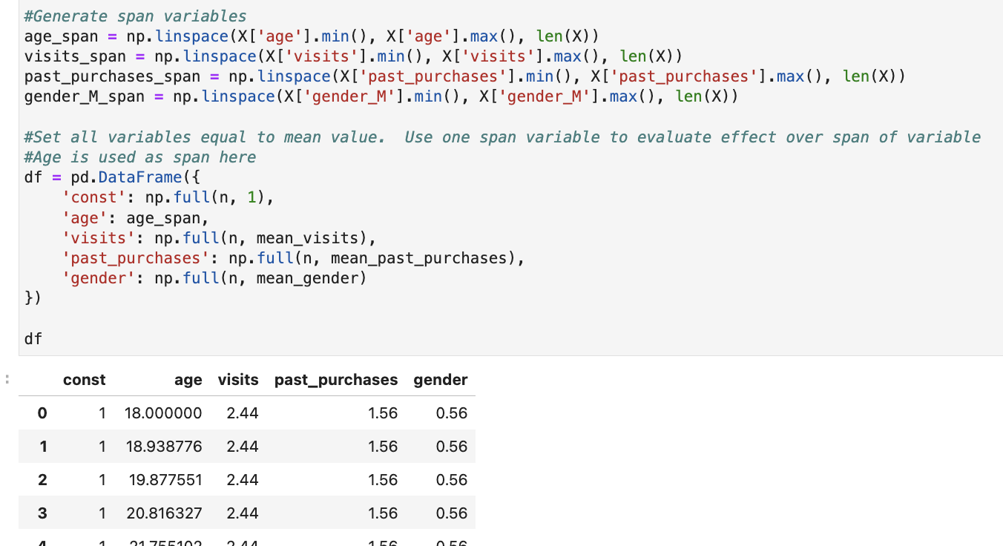
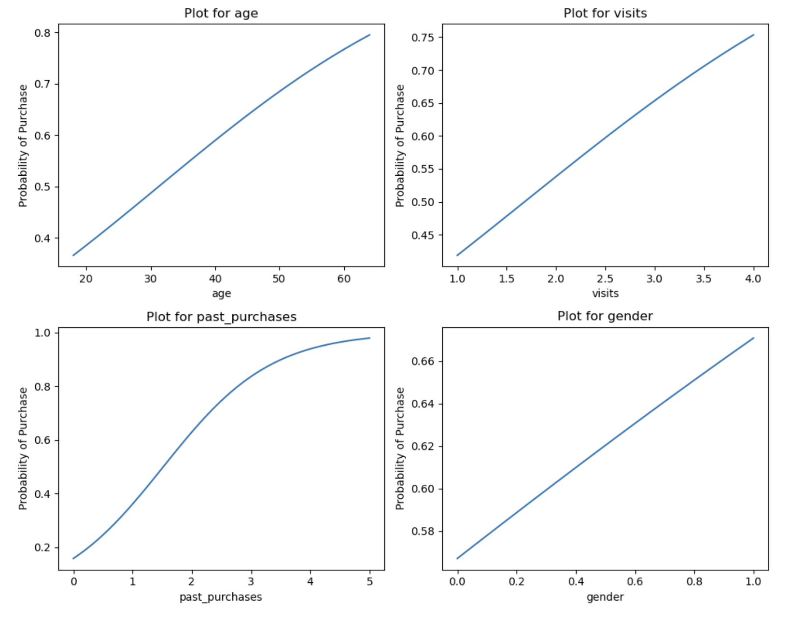
Simulation
Create span variables that are equally spaced values of n length that range from the highest to lowest values of each variable
Set each variable equal to its mean (or any other values you want to use), except the one you want to investigate
Calculate predictions and see how p(y=1) changes as other variable moves from lowest to highest values

Slide 21
Ordered Logistic Regression
What if dependent variable is ordinal?
Example: 1 if totally dissatisfied, 2 if slightly dissatisfied, 3 if neither satisfied nor dissatisfied, 4 if slightly satisfied, 5 if highly satisfied.
OLS assumptions are violated (heteroskedasticity & interval / ratio scale)
Complications:
Proportional odds required - differences between categories must be equal / interpreted as equal
Slightly more complicated interpretation

